Slide 1
Acquisition Analytics
By: Pramodini V. Nayak

Slide 2
Abstract
Objective:
To build a response model for the bank marketing data set. The business objective is to achieving 80% of total responders for a loan product at the minimum possible cost.
Problem statement:
We have to build the model without ‘duration’ as variable. Because, the prospect data procured by the marketing team will not contain ‘duration’, since the call has not been made yet.

Slide 3
Analysis methodology
Data collection and cleaning Import the data Identifying the data quality issues and clean the data
Visualizing the data Visualizing original data variables to look for any pattern or correlation. Analyzing the outlier and treating accordingly.
Data preparation Dropping duration column Creating dummy variables. Test and train split of the data. Standardizing all the continuous variables.
Decision Making Based on business objective to achieve 80% of total responders selecting suitable number of decile. Calculating average call duration for targeting 80% responders. Calculating cost of acquisition Calculating the amount saved after the influence of the model.
Modelling and Evaluation Feature selection using RFE for selecting top 20 variables. Using GLM statsmodel to select significant variables. Hyperparameters tuning our model. Finding optimal probability cut-off. Prediction on test data. Evaluating the model accuracy , sensitivity and specificity.

Slide 4
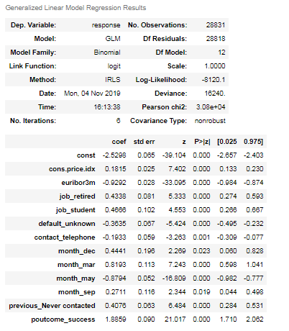
Feature selection using RFE and stats-model:
Our final model has 12 features.
The variables with positive co-efficient effect the output positively. Variables such as: retired, students etc.
The variables with negative co-efficient effect the output negatively. Variables such as: contacting via telephone, euribor3m etc.

Slide 5
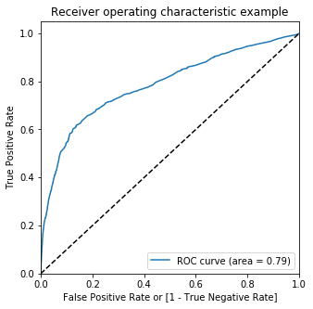
ROC curve
The area under the curve of the ROC is 0.79 which is quite good.

Slide 6
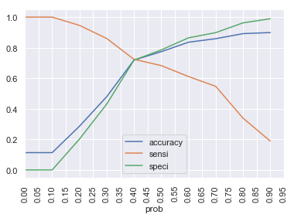
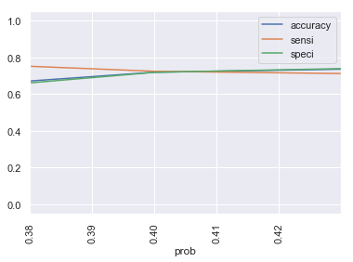
Optimal Probability Cut off
We see that the optimal probability cut-off is 0.405.
With 0.405 as cut-off, our model evaluation are as follow:
Accuracy is 72.02 %
Sensitivity is 70.26%
Specificity is 72.24%

Slide 7
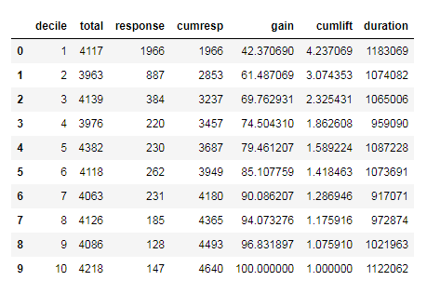
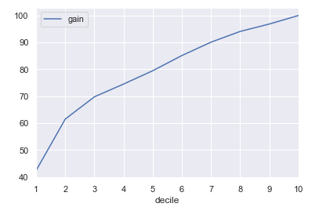
X % target analysis
We see from the table that from top 5 decile we get 79.46% (Approx. 80%) of response. This can be confirmed again from gain graph.
But if we want exact 80% or above 80%(85.10%) we can reach out to top 6 decile. However, it will cost us additional 4118 calls.

Slide 8
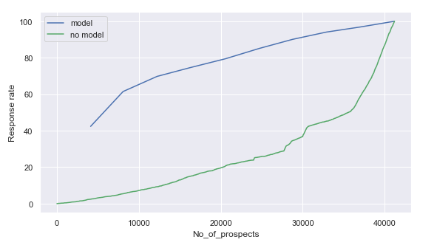
Lift chart
By looking at the lift chart we clearly see that, model has huge influence on response rate.
By contacting 20000 prospects we had only 20% response rate. But by using logistic regression model we see a response rate of 80% for the same number of contacts.

Slide 9
Summary
By using logistic regression model for analyzing bank marketing data without the ‘duration’ variable, we found the following observation:
The average call duration for targeting the top 80% prospects is 261 seconds, which is about 4.35 minutes.
Cost of acquisition:
If we assume that Cost for each call will be cost per minute*duration:
Cost for targeting 80% prospects = Rs. 44, 737.29
Cost for targeting all the customer = Rs. 87,301.13.
So we save Rs. 42,563.84 which is approx. 49% savings.
B. If we assume that Cost = 1*number of contacts made in the current campaign:
Cost for targeting 80% prospects = Rs. 20, 577
Cost for targeting all the customer = Rs. 41,188.
So we save Rs. 20,611 which is approx. 50% savings.
Note: Assumed the cost of call is 50 paisa per minute.

